Slide 1
Data/Metadata Harvesting (OAI-PMH) APIs, HTTP
Fernando Aguilar

Slide 2
Repositories/Catalogues
Web portals to store Digital Objects: Papers, Datasets, Pictures, Images, etc.
Open:
Open Data: Governments, Cities, etc.
Closed:
Department, Scientific Community…
Public:
Zenodo, FigShare, DataONE.
Private:
Invenio, DSpace (software to be installed).
Data Harvesting: Enabling Machine-actionable features for allowing automatic information gathering.
From heterogeneous repositories.

Slide 3
HTTP protocol
A communications protocol
Allows retrieving inter-linked text documents (hypertext)
World Wide Web.
HTTP Verbs
HEAD
GET
POST
PUT
DELETE
TRACE
OPTIONS
CONNECT
GET /index.html HTTP/1.1
Host: www.pitt.edu
Browser
Web Server
HTTP/1.1 200 OK
Content-Type: text/html
<html><head>…

Slide 4
Representational State Transfer (REST)
A style of software architecture for distributed hypermedia systems such as the World Wide Web.
Introduced in the doctoral dissertation of Roy Fielding
One of the principal authors of the HTTP specification.
A collection of network architecture principles which outline how resources are defined and addressed

Slide 5
REST and HTTP
The motivation for REST was to capture the characteristics of the Web which made the Web successful.
URI Addressable resources
HTTP Protocol
Make a Request – Receive Response – Display Response
Exploits the use of the HTTP protocol beyond HTTP POST and HTTP GET
HTTP PUT, HTTP DELETE

Slide 6
Frameworks to develop APIs
SWAGGER
https://swagger.io
https://petstore.swagger.io/

Slide 7
Resources
The key abstraction of information in REST is a resource.
A resource is a conceptual mapping to a set of entities
Any information that can be named can be a resource: a document or image, a temporal service (e.g. "today's weather in Los Angeles"), a collection of other resources, and so on
Represented with a global identifier (e.g. URI in HTTP)
https://es.wikipedia.org/wiki/La_Gioconda

Slide 8
Naming Resources
REST uses URI to identify resources
http://localhost/books/
http://localhost/books/ISBN-0011
http://localhost/books/ISBN-0011/authors
http://localhost/classes
http://localhost/classes/cs2650
http://localhost/classes/cs2650/students
As you traverse the path from more generic to more specific, you are navigating the data

Slide 9
Verbs
Represent the actions to be performed on resources
HTTP GET
HTTP POST
HTTP PUT
HTTP DELETE

Slide 10
HTTP GET
How clients ask for the information they seek.
Issuing a GET request transfers the data from the server to the client in some representation
GET http://localhost/books
Retrieve all books
GET http://localhost/books/ISBN-0011021
Retrieve book identified with ISBN-0011021
GET http://localhost/books/ISBN-0011021/authors
Retrieve authors for book identified with ISBN-0011021

Slide 11
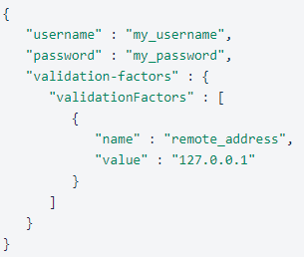
HTTP POST
Creates/Updates a resource
Sends data from client to server.
In general, it produces a change
POST http://localhost/books/
Content: {title, authors[], …}
Creates a new book with given properties
Headers
Content-Type: application/json
Accept: application/json
Data
>>> r = requests.post('https://httpbin.org/post', data = data, header=header)

Slide 12
HTTP PUT
HTTP PUT updates a resource
PUT http://localhost/books/isbn-111
Content: {isbn, title, authors[], …}
Updates book identified by isbn-111 with submitted properties

Slide 13
HTTP DELETE
Removes the resource identified by the URI
DELETE http://localhost/books/ISBN-0011
Delete book identified by ISBN-0011

Slide 14
Representations
How data is represented or returned to the client for presentation.
Two main formats:
JavaScript Object Notation (JSON)
XML
It is common to have multiple representations of the same data

Slide 15
Representations
XML
<COURSE>
<ID>CS2650</ID>
<NAME>Distributed Multimedia Software</NAME>
</COURSE>
JSON
{course:
{id: CS2650}
{name: Distributed Multimedia Software}
}

Slide 16
Architecture Style
Request
(XML doc)
HTTP GET
URL 1
doGet()
Response
(XML doc)
HTTP Response
doPost(id)
Request
(XML doc)
HTTP POST
URL 1
REST Engine
(locate resource and generate response)
Web/Proxy Server
Response
(JSON doc)
HTTP Response
doDelete()
PO
(XML doc)
HTTP DELETE
URL 1
Response
(TEXT doc)
HTTP Response

Slide 17
OAI-PMH Overview
The Open Archives Initiative: “...develops and promotes interoperability standards that aim to facilitate the efficient dissemination of content.”
OAI-PMH (Open Archives Initiative – Protocol for Metadata Harvesting): “...defines a mechanism for harvesting records containing metadata from repositories.”
Data Providers: “...maintains one or more repositories (web servers) that support the OAI-PMH as a means of exposing metadata.”
Archive-IT, Libraries, Data Repositories
Service Providers: “...issues OAI-PMH requests to data providers and uses the metadata as a basis for building value-added services.”
think OCLC’s WorldCat catalog ...

Slide 18
Record Harvesting

Slide 19
Record Harvesting
OAI-PMH is based on the HTTP protocol and XML standard.
Uses 6 main request types:
Identify ListMetadataFormats ListSets ListIdentifiers ListRecords GetRecord
More detailed explanation of each in online documentation
These request types are appended to a base URL:
Archive-It: http://archive-it.org/oai
Digital.CSIC: http://digital.csic.es/dspace-oai/

Slide 20
Record Harvesting
Example “GetRecord” request: http://archive-it.org/oai?verb=GetRecord&metadataPrefix=oai_dc&identifier=http://archive-it.org/collections/2349
archive-it.org/oai
The Base URL
verb=GetRecord
...return a single record
metadataPrefix=oai_dc
...in the oai_dc (Dublin Core) format
identifier=http://archive-it.org/collections/2349
...with the identifier “http://archive-it.org/collections/2349”
this is also conveniently the URL to the collection public page

Slide 21
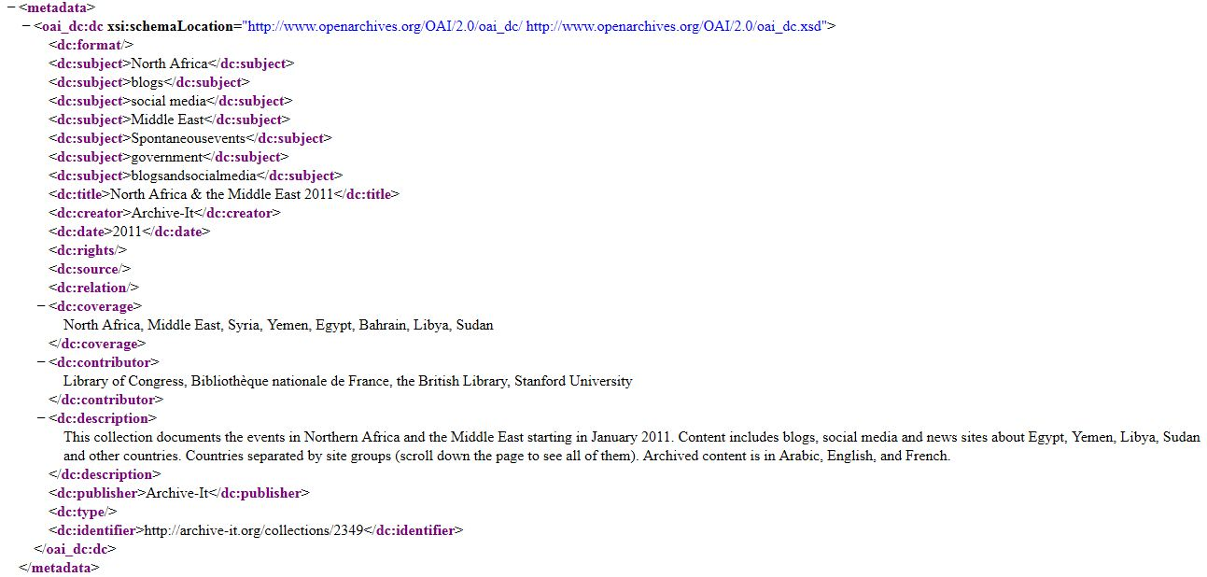
Record Harvesting
(Example GetRecord request: http://archive-it.org/oai?verb=GetRecord&metadataPrefix=oai_dc&identifier=http://archive-it.org/collections/2349)

Slide 22
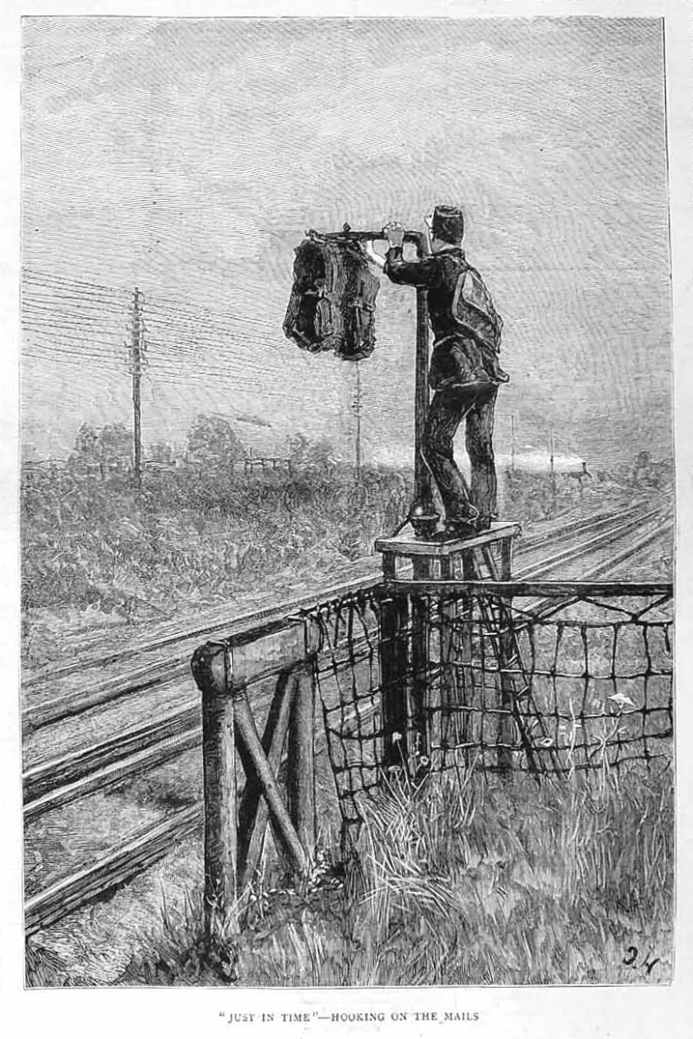
Collection
Metadata

Slide 23
Field Mapping (or, How did that get there?)

Slide 24


Field Mapping
Archive-It Metadata Entry screen
Archive-It OAI-PMH XML feed
OCLC WorldCat Catalog

Slide 25
Field Mapping: WorldCat Catalog
Archive-It/OAI-PMH Dublin Core fields | WorldCat Catalog Fields
<title> | Title
<creator> | Author
<subject> | Subject Fields (on right & bottom)
<description> | Summary
<publisher> | Publisher
<contributor> | Contributor(s)
<date> | Date (located after Publisher)
<type> | Pre-populated as “Archival Material”
<format> | ...
<identifier> | Archive-It URL --> “view online” link
<source> | ...
<relation> | ...
<coverage> | Notes
<rights> | ...

Slide 26
Field Mapping: <identifier>
We utilize the “Identifier” field, from the collection level Dublin Core metadata, to append the unique URL of your collection to the OAI-PMH metadata record
Providing a URL back to the original record (in our case, the Archive-It web collection) is central to the philosophy and functionality of OAI-PMH

Slide 27
Field Mapping: Moral of the Story
While creating collection level metadata, think ahead to how these fields will be “mapped” to a record display in aggregators like the WorldCat catalog
Consult Best Practices in metadata creation:
Great OCLC article about creating “shareable” metadata:
www.oclc.org/gateway/support/best_practices.pdf
breakdown of Dublin Core elements:
http://dublincore.org/documents/usageguide/elements.shtml

Slide 28
OAI-PMH Server Structure

Slide 29
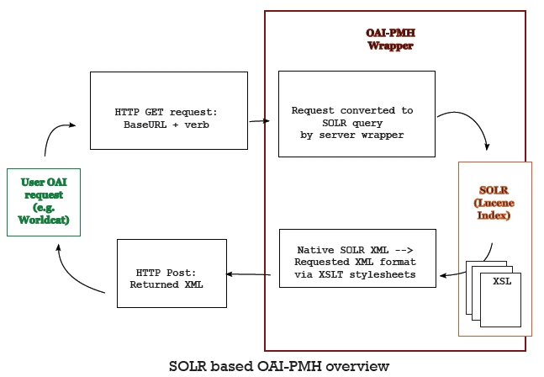
A Solr based approach

Slide 30
Benefits of a SOLR based OAI-PMH server
Dynamically updated? It is the database index!
Update collection level metadata, reflected in OAI-PMH fee immediately
Solr central to the Archive-It platform
No stand-alone, 3rd party software requiring maintenance or updates
the XSLT stylesheets and servlet wrapper developed in-house
And it’s FAST.

Slide 31
Sets

Slide 32
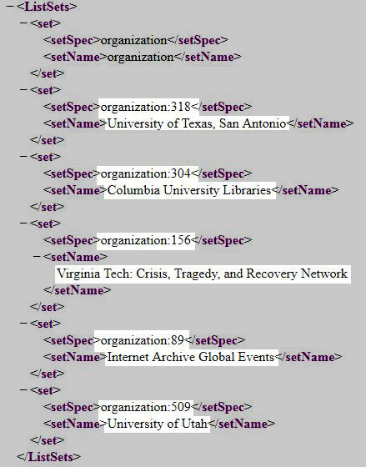
Sets

Slide 33
Sets
currently, sets are automatically generated only at the partner / organization level
ability to export all collection level metadata
coupled with the ability to “crosswalk” from one metadata schema to another –MARCXML for example - this would facilitate adding collection records to local catalogs
records can belong to multiple sets

Slide 34
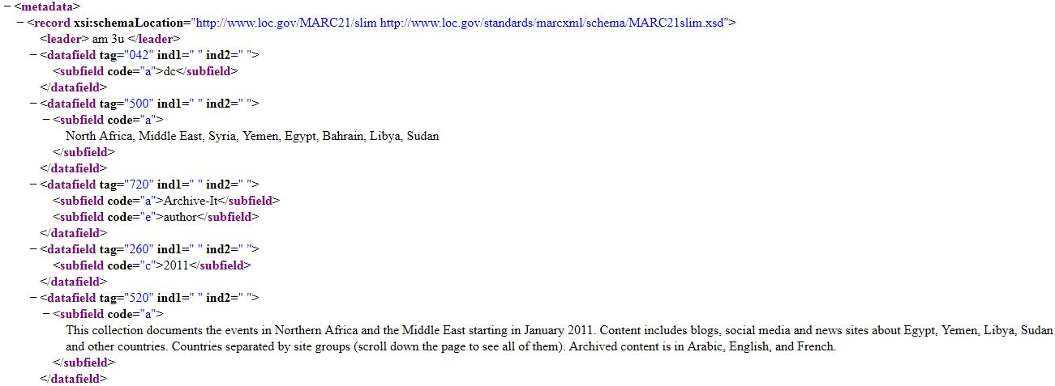
MARCXML / MARC21 example
http://archive-it.org/oai?verb=GetRecord&metadataPrefix=oai_marc21&identifier=http://archive-it.org/collections/2349
Change the Metadata Prefix from “oai_dc” --> “oai_marc21”
Working to add more metadata formats: MODS, EAD, METS...

Slide 35
OAI-PMH: General Steps
Check available metadata schemas
Select the schema to be used
Search/Find resource (List sets, List resource)
Get resource

